Slide 1
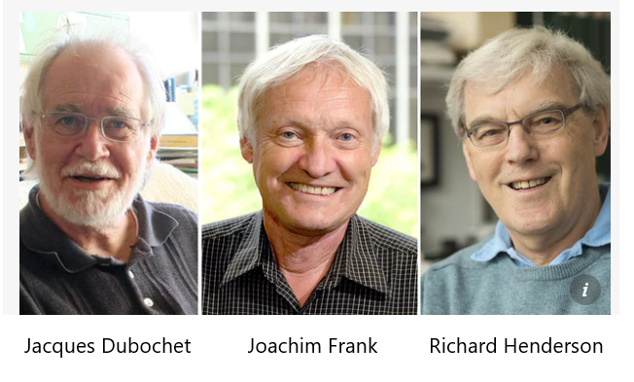


COAUTHOR
Analyzing Model Bias in Cryo-EM
Single-Particle Image Processing
Shao-Hsuan Wang
Institute of Statistical Science, Academia Sinica
This is a joint work with
The Nobel Prize in Chemistry 2017
Yi-Ching Yao
Institute of Statistical Science, Academia Sinica
Wei-Hau Chang
Institute of Chemistry, Academia Sinica
I-Ping Tu
Institute of Statistical Science, Academia Sinica
NEWS
for developing cryo-electron microscopy(Cryo-EM)
Notes:
Good morning, I’m Shao-Hsuan Wang, I’m a postdoc for currently working at the Institute of statistical science academia sinica.
Today, we are going to talk: Analyzing model bias in cryo-EM single-particle image processing.
This is a work joint with Dr. Yao, Yi-Chin, Dr. Chang Wei-Hau, and Dr. Tu, I-Ping.
We start with the news: last year, the Nobel prize in Chemistry was awarded jointly to three scientists for developing cryo-electron microscopy. It it means Cryo-EM is a very important field in modern science.

Slide 2

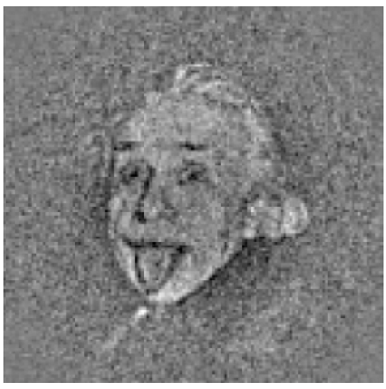
Henderson R. (2013) Avoiding the pitfalls of single
Particle Cryo-electron microscopy: Einstein from noise
Notes:
Henderson, a Nobel Prize winner, wrote a scientific article: avoiding the pitfalls of single-particle cryo-electron microscopy: Einstein from noise.
Look at this picture, after alignment to the model using cross-correlation function, Einstein emerges from 1000 random images.
Model bias is a very important issue in cryo-EM and This motivates us to study model bias.

Slide 3
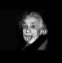
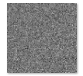
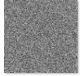
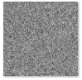
Model Bias Experiment
1,000 Random images
Reference image
Average image
Alignment using
Cross correlation(CC)
Notes:
In the experiment, we set Einstein be a reference image with size 100 x 100. We generate 2 million random images. By using cross correlation function, we sort their CC values and average the first 600 images. So what is the result, guess it ?
The answer is Einstein! It is surprising! Each random image has no Einstein at all, but the average image shows Einstein! It is the so-called model
bias

Slide 4
Question is
How does model bias happen?
Question is
Can we construct a mathematical framework for model bias?
Can we give a model bias measure?
Notes:
In the experiment, we set Einstein be a reference image with size 100 x 100. We generate 2 million random images. By using cross correlation function, we sort their CC values and average the first 600 images. So what is the result, guess it ?
The answer is Einstein! It is surprising! Each random image has no Einstein at all, but the average image shows Einstein! It is the so-called model
bias

Slide 5
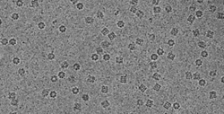
OUTLINE
Some Background of Cryo-EM
Image Alignment and Model Bias
Asymptotic Theory
Simulation Results
Conclusion
Notes:
In today presentation, I’ve divided into five parts:
The first is, some background of cryo-EM and
the second is image alignment and model bias.
And we give the asymptotic theory, simulation results, and the conclusion

Slide 6
Some Background of Cryo-EM

Slide 7
Why do many of scientists favor cryo-EM
Some of the proteins are
thousands times of smaller than the width of a human hair
Human body
Notes:
Why do many of scientists favor cryo-EM? In human body , some of the proteins are so tiny and complex we haven’t been able to see or study them.
This is a human hair. Some of the proteins are thousands times of smaller than the width of a human hair.

Slide 8
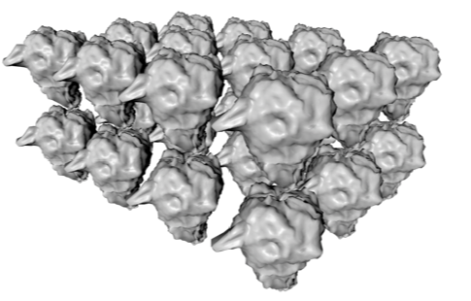
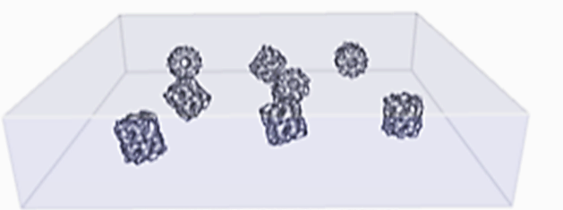
Why do many of scientists favor cryo-EM
X-ray Crystallography
X-ray
Crystallized Sample
But, some proteins could not be formed into crystals !!!!
Cryo-EM
Electron-beam
Frozen protein sample
Notes:
Traditionally, the scientists use the technique X-ray crystallography to take pictures for tiny proteins. But some proteins could not be formed into crystals.

Slide 9

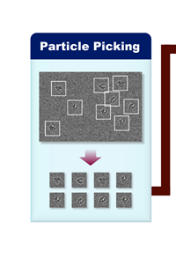
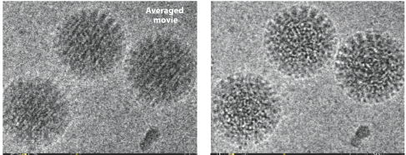
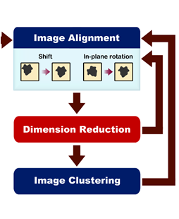
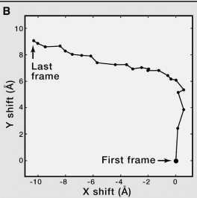
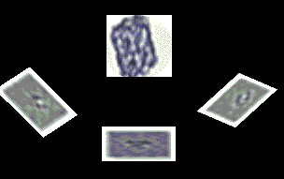
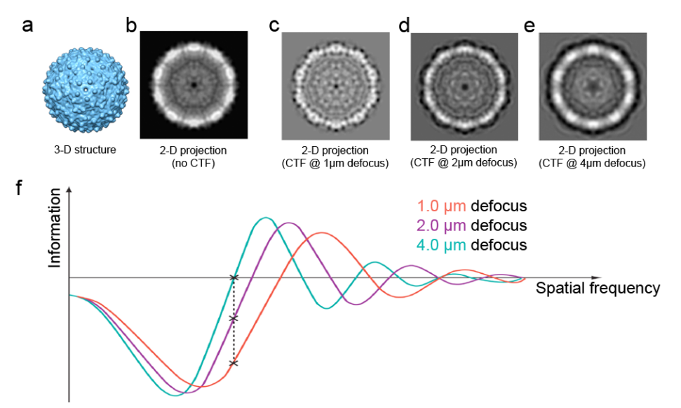
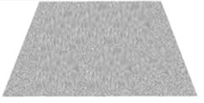
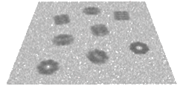
Cryo-EM Analysis Workflow
Motion、CTF
Corrections
Single Particle
Image
3D Reconstruction
2D Clustering
Motion、CTF
Corrections
Single Particle
Image
2D Clustering
3D Reconstruction
Initial Volume
3D Classification
Initial Volume
3D
Refinement
3D Classification
3D
Refinement
Notes:
We can see cryo-EM workflow. We take pictures and get the projection image from different molecules.
We do motion, CTF correction, we do particle picking. We do 2D clustering, align the similar particle. Finally, we do
3D reconstruction to recover the porteins
In cyro-EM, image alignment is an changeling problem.

Slide 10
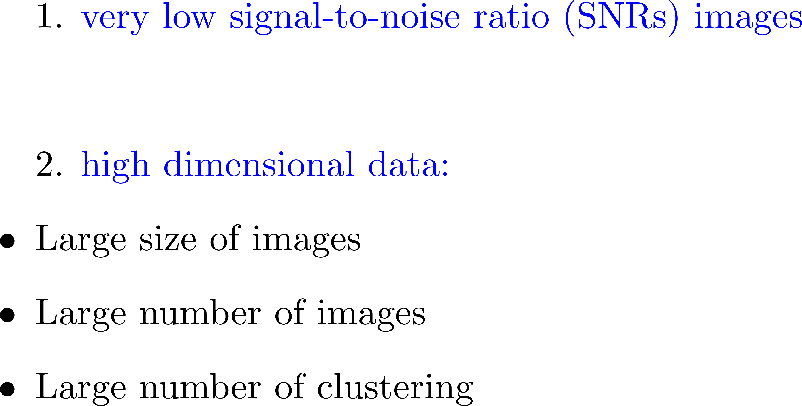
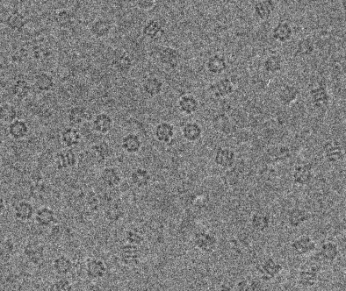
Challenge of image alignment:
Notes:
Why is alignment so challenging ? We can see the two points:
The first, is images have very low signal-to-noise ratio;
because high electron does can destroy the biology Molecule, low electron does is need to preserve the shape of molecules. So we always picture very noisy images.
Look at , can you clearly see how many molecules in the picture?
Second, cryo-EM involves high dimensional data. Large number of images and big size of images. In such high dimensional and noisy data,
Image alignment possibly leads to model bias.

Slide 11
Image Alignment and Model Bias
Notes:
So what is model bias, how dose model bias happen

Slide 12
Cross correlation (CC)
(for normalized images)
vec(X)
vec(Y)
X
Y
Notes:
Before we answer the question, we introduce an alignment measure: Cross correlation, shorten CC.
For two normalize images, we can convert them into matrices in programming, for example, python, matlab.
Then we can convert them into vectors. Cross correlation is a correlation between them. If cross correlation is close to 1 or -1,
two images are similar. If cross correlation is close to zero, two images are not similar.

Slide 13
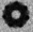
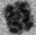
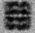
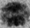
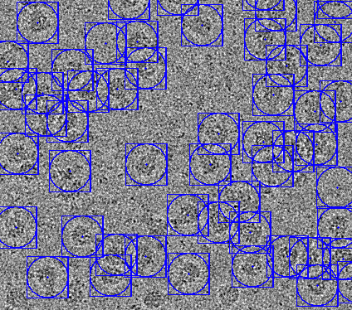
Reference image
Rotation and translation
Cross correlation (CC) function
Candidate particles
Average the first m images
average image
Notes:
In order to get a clear image, set a picture be a reference image., pick up candidate particles and align them.
We select candidate particles and cut them out of the image. By using cross correlation function, by rotation and translation,
we can align each candidate particles and compute their CC values.
We sort CC values and average the first m images, and then, we get an average image. The average image provides a more detail of
the molecule.

Slide 14
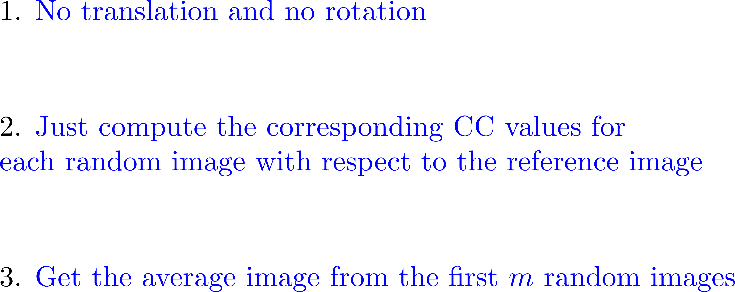
Simplified Model Bias Experiment:
Notes:
In order to see model bias problem, we start with an experiment: Einstein from noise.

Slide 15
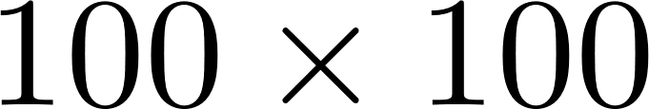
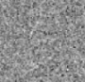
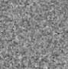
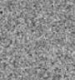
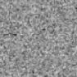
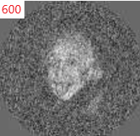
Reference image
Cross correlation (CC) function
2,000,000
Random images
Average the first 600 images
average image
Notes:
In the experiment, we set Einstein be a reference image with size 100 x 100. We generate 2 million random images. By using cross correlation function, we sort their CC values and average the first 600 images. So what is the result, guess it ?
The answer is Einstein! It is surprising! Each random image has no Einstein at all, but the average image shows Einstein! It is the so-called model
bias

Slide 16
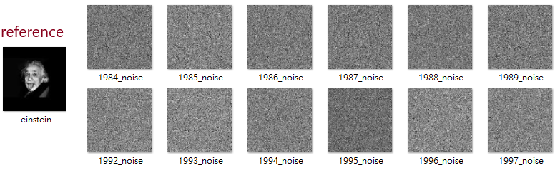
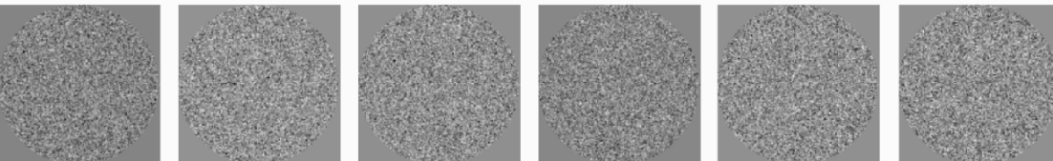
2057 of 2,000,000 images (CC > 0.03)
The first 6 largest: 0.046, 0.045, 0.044, 0.044, 0.044, 0.043
Notes:
We can see more detail. 2 million random images, only 2057 CC values are larger than 0.03.
The first 6 largest CC values are about 0.04

Slide 17
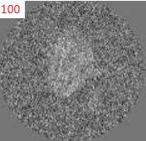
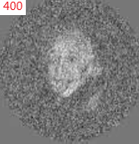
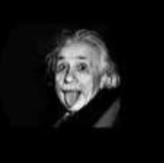
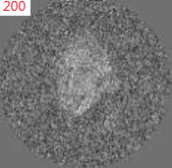
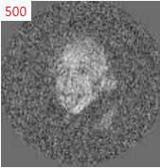
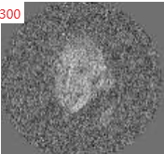
CC: 0.374
CC: 0.600
CC: 0.485
CC: 0.639
CC: 0.554
CC: 0.665
Notes:
But when We sum the first 100, 200, 300 and so on.
Einstein is getting clear
CC value is getting large.
Model bias is interesting but challenging problem. The principle behind model bias could be unclear.

Slide 18
Question is
How does model bias happen?
Notes:
However, question is
When we average images, is the red vector always gone?

Slide 19
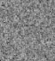
How dose model bias happen
Reference vector
Random vector
Notes:
To build a mathematical framework, we see how model bias happen
Let reference vector be an orange vector, let random vector be an black vector.
For each random vector, we can decompose it into two perpendicular vectors.
One is a projection on the orange vector, it is a blue vector. The other is a projection
Orthogonal to reference vector, it is a red vector.

Slide 20
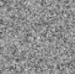
Reference vector
Random vector
The first m images
Notes:
When we sum random images, the red vector is gone.
Average image only remains a blue vector. This is the reason why Einstein appears.
This is a principle behind model bias!

Slide 21
Reference vector
Random vector
The first m images
Notes:
When we sum random images, the red vector is gone.
Average image only remains a blue vector. This is the reason why Einstein appears.
This is a principle behind model bias!

Slide 22
The first m images
Notes:
When we sum random images, the red vector is gone.
Average image only remains a blue vector. This is the reason why Einstein appears.
This is a principle behind model bias!

Slide 23
How dose model bias happen
Question is
When we average images,
does the average red vector always get small?
Notes:
When we sum random images, the red vector is gone.
Average image only remains a blue vector. This is the reason why Einstein appears.
This is a principle behind model bias!

Slide 24
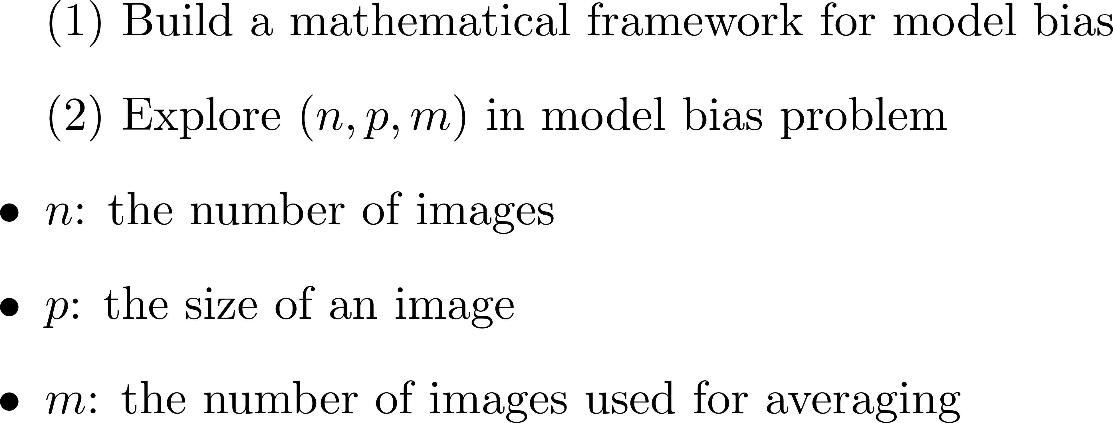
Our work:
Notes:
Our work is divided into two parts
The first is
Build a mathematical framework for model bias
and the second is explore (n,p,m) in this problem
In which
N is the number of images
P is size of an images
M is the number of images used for averaging

Slide 25
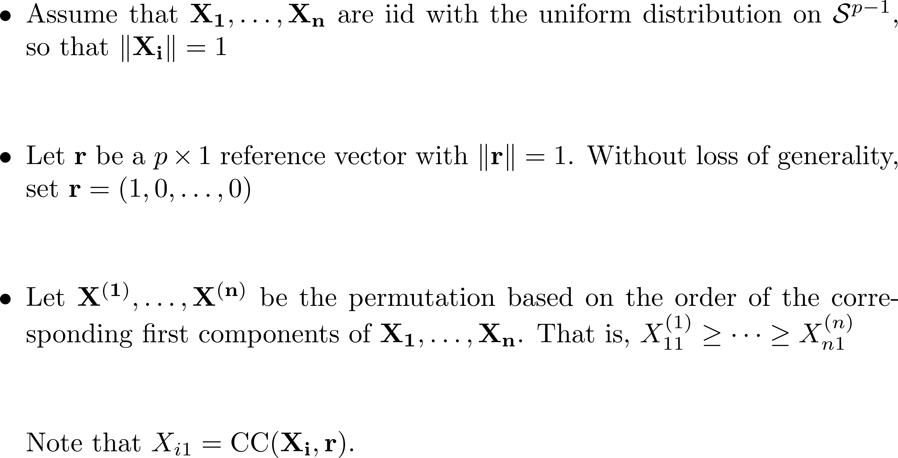
Notation
Notes:
We can see the problem from a mathematical view.
W first give some notations. Assume that …
Uniform distribution means they uniformly lie on the surface of a ball.
Set r be North Pole

Slide 26
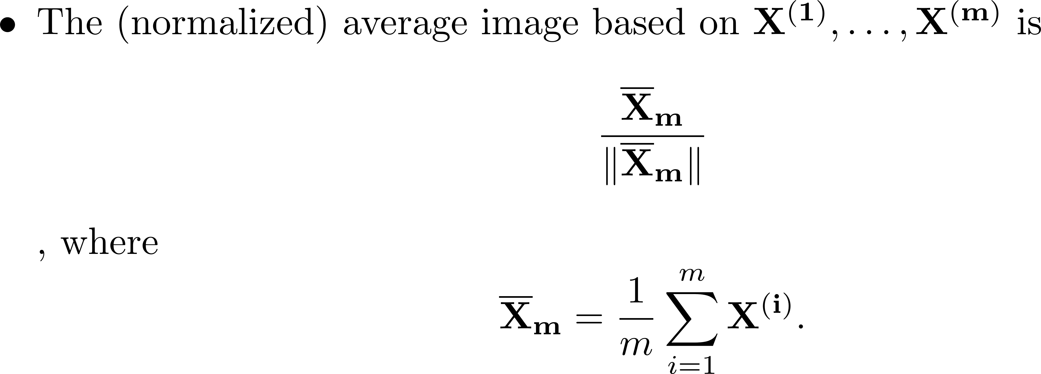
Notes:
We can get a formula of the normalized average image

Slide 27
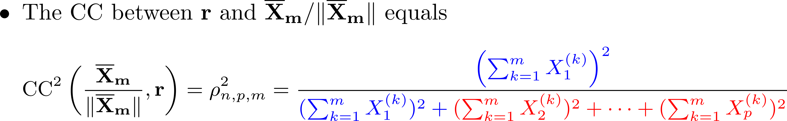
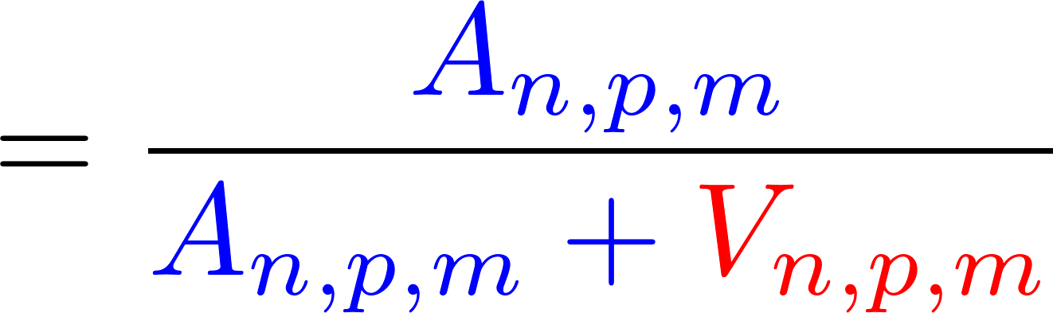
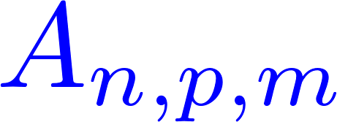
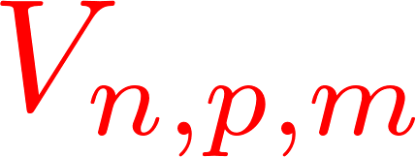
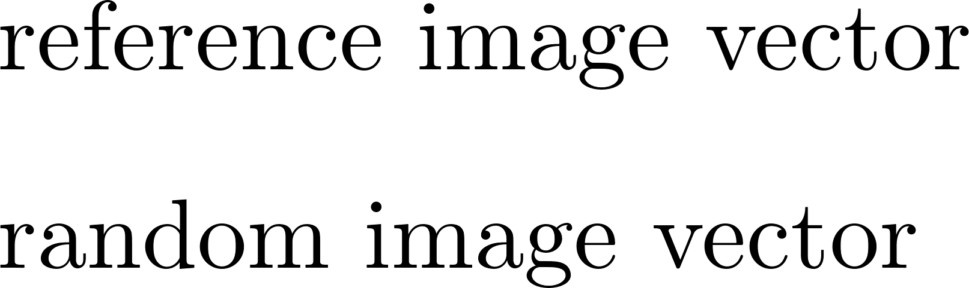
Notes:
and we have a formula of CC between reference image and average image
Note that cross correlation can be simplified by A and V
A is a square length of projection on reference vector,
V is a square length of projection orthogonal to reference vector
Based on Cai, Fan Jiang.. A equals
For an average image, … V equals

Slide 28
Notes:
and we have a formula of CC between reference image and average image
Note that cross correlation can be simplified by A and V
A is a square length of projection on reference vector,
V is a square length of projection orthogonal to reference vector
Based on Cai, Fan Jiang.. A equals
For an average image, … V equals

Slide 29
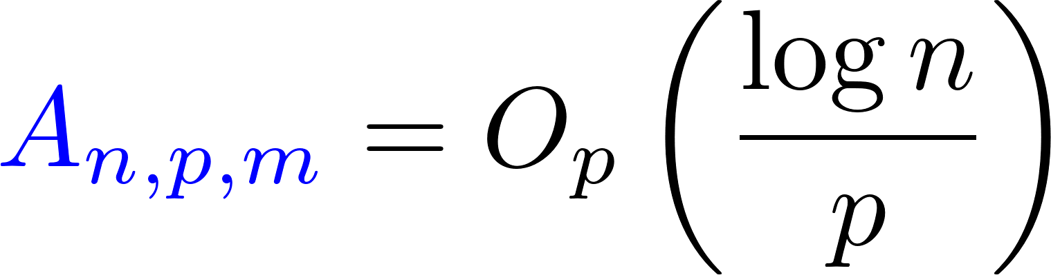




Notes:
Again, we can see that A and V
consider a ratio of A to V and this ratio equals Op
This ratio determines how fast A goes zero than V

Slide 30


Model bias!!!!!!
Notes:
Recall ration A to V equals to Op
when mlog n/p converges a nonzero value, model bias happens
Can we give estimations for the ratio and rho?
Next part, we will provide consistency theorem and
Asymptotic theorem.

Slide 31
Asymptotic Theory

Slide 32
Model bias measure:
Notes:
When we sum random images, the red vector is gone.
Average image only remains a blue vector. This is the reason why Einstein appears.
This is a principle behind model bias!

Slide 33

Notes:
From Consistency theorem is under m/n -> 0 and (\log n) /p ->0 , we have the following results.
By this theorem, we can use beta to estimate ratio of A to V and rho square, which determining model bias.
It is very powerful !

Slide 34





Our estimation
Reference image (100 x 100)
Cross correlation (CC) function
CC: 665
Average image
2,000,000 Random images
Notes:
Come back Einstein form noise,
We have n=2millon , p=10,000, m=600/
Ratio of A to V is about 0.815, it is not small
Cross correlation is 0.670, it is close to the experimental result.

Slide 35

Convergence rate:
Notes:
When we sum random images, the red vector is gone.
Average image only remains a blue vector. This is the reason why Einstein appears.
This is a principle behind model bias!

Slide 36

Notes:
Form Asymptotic theorem, under m(log log n)^4/log(n) -> 0 and square of (\log n) /p ->0 , we have the following result.
We
Alpha is a rate such that the cross correlation has asymptotic normality

Slide 37



Statistical and physical meaning
pure noise
asymptotic normality
model bias measure
Convergence rate
Notes:
In this slide, we can see the meaning in statistics and physics.
First ..
Beta means the ratio of A of V, so beta can characterize model bias.
Alpha is a rate such that cross correlation has asymptotic normality.

Slide 38

Cross Correlation Decomposition
Notes:
From decomposition of cross correlation, it is helpful to understand the consistency and normialty. Roughly,
Cross correlation is determined by two independent standard normal rv.

Slide 39







Notes:
Based on m log n/p and m^{1/2}log n/ p^{1/2}, we can consider five situations. Recall that m\log n/p is about ratio of A to V.
When m log n/p goes to nonzero, model bias happens.

Slide 40


model bias
Notes:
Based on m log n/p and m^{1/2}log n/ p^{1/2}, we can consider five situations. Recall that m\log n/p is about ratio of A to V.
When m log n/p goes to nonzero, model bias happens.

Slide 41
















 | No Model bias |  |  | Model bias
Notes:
Based on m log n/p and m^{1/2}log n/ p^{1/2}, we can consider five situations. Recall that m\log n/p is about ratio of A to V.
When m log n/p goes to nonzero, model bias happens.

Slide 42
Simulation Results
Notes:
In the simulation result, we consider two cases.

Slide 43
Case 1. n=20,000, p=10,000
Case 2. n=2,000,000, p=10,000
m=100, 200, 300, 400, 500, 600
Notes:
In the simulation result, we consider two cases.

Slide 44

Notes:
We do simulation in 100 runs and average values to be true value because sd is very small.
From table 1 and table 2, we can see that our estimation is accurate

Slide 45


Fig 1. n=20,000, p=10,000
Fig 2. n=2,000,000, p=10,000
Notes:
Next, we can see the performance of our estimation compared to standard normal distribution. From figure 1, when m is large, there
Is a bias between two curves. It is because larger m violates the assumption m(loglog n)^4/(log n)^2. From figure 2,
, we can see when n is getting large, estimation is more accurate.

Slide 46
Conclusion

Slide 47
Notes:
In this slide, we can see the meaning in statistics and physics.
First ..
A is a square length of projection on reference vector,
V is a square length of projection orthogonal to reference vector
Beta means the ratio of A of V, so beta can characterize model bias.
Alpha is a rate such that cross correlation has asymptotic normality.

Slide 48

Notes:
In this slide, we can see the meaning in statistics and physics.
First ..
A is a square length of projection on reference vector,
V is a square length of projection orthogonal to reference vector
Beta means the ratio of A of V, so beta can characterize model bias.
Alpha is a rate such that cross correlation has asymptotic normality.

Slide 49

Notes:
From Consistency theorem is under m/n -> 0 and (\log n) /p ->0 , we have the following results.
By this theorem, we can use beta to estimate ratio of A to V and rho square, which determining model bias.
It is very powerful !

Slide 50

Notes:
Form Asymptotic theorem, under m(log log n)^4/log(n) -> 0 and square of (\log n) /p ->0 , we have the following result.
We
Alpha is a rate such that the cross correlation has asymptotic normality

Slide 51


Slide 52
Thank you for your listening

